Slide 1
18CSE354T
NETWORK SECURITY NOTES
UNIT – 2

Slide 2



UNIT - 2 TOPICS
 Overview of IPSEC
 Security Association
 Security Association DB
 Security Policy DB
 AH & ESP
 Tunnel and Transport Mode
 IP Header Protection
 IP and IPv6
 IPV4 and IPV6 header
 Authentication Header
 Mutable,Immutable and Mutable but predictable
 Encapsulation Security
Payload(ESP)
 Internet Key Exchange
 Phases of IKE
 Phase I IKE – Modes and key types
 Phase I IKE Protocols
 Phase II IKE
 ISAKMP / IKE Encoding

Slide 3

IP SECURITY
 Have a range of application-specific security mechanisms
 E.g. S/MIME, PGP, Kerberos, SSL/HTTPS
- however, there are security concerns that cut across protocol layers
 People would like security to be implemented by the network for all applications

Slide 4

IPSEC
 General IP Security mechanisms provides
 authentication
 confidentiality
 key management
 Applicable to use over LANs, across public & private WANs, & for the Internet

Slide 5

APPLICATIONS OF IPSEC
 Build a secure virtual private network over the Internet or over a public WAN.
 Secure remote access over the Internet to his company, for example.
 Establishing extranet and intranet connectivity with partners
- ensuring authentication and confidentiality and providing a key exchange mechanism
 Enhancing electronic commerce security

Slide 6
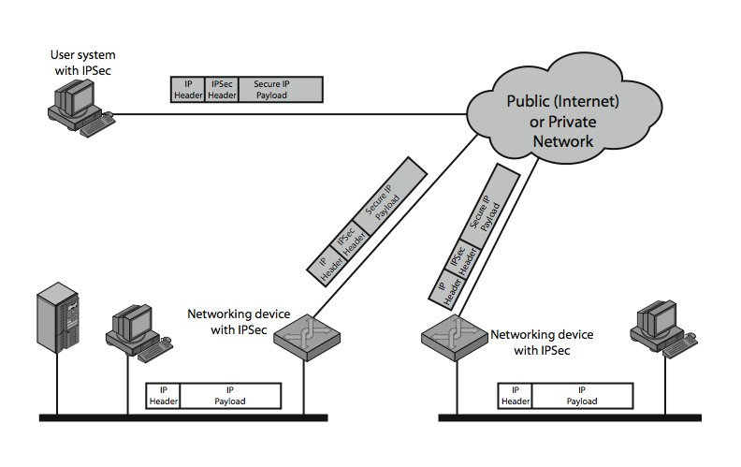

Slide 7

BENEFITS OF IPSEC
 IPSec in a firewall/router provides strong security to all traffic crossing the perimeter
 IPSec in a firewall/router is resistant to bypass traffic as long as all traffic is IP
 IPSec is below transport layer, hence transparent to applications
 IPSec can be transparent to end users
 IPSec can provide security for individual users
 IPSec secures routing architecture

Slide 8

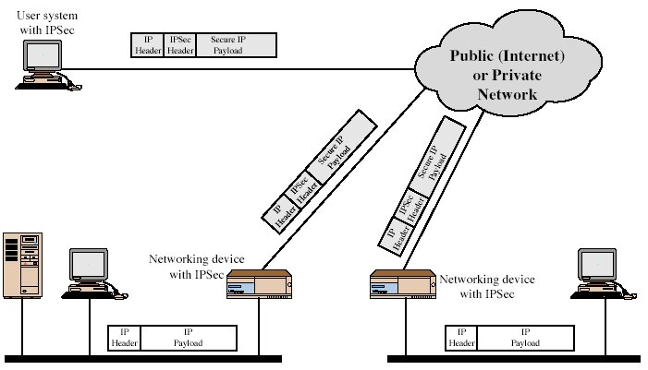
IPSEC USES

Slide 9
IP SECURITY ARCHITECTURE
 Specification is quite complex
 Defined in numerous RFC’s
 incl. RFC 2401/2402/2406/2408
 many others, grouped by category
 Mandatory in IPv6, optional in IPv4
 Have two security header extensions:
 Authentication Header (AH)
 Encapsulating Security Payload (ESP)

Slide 10
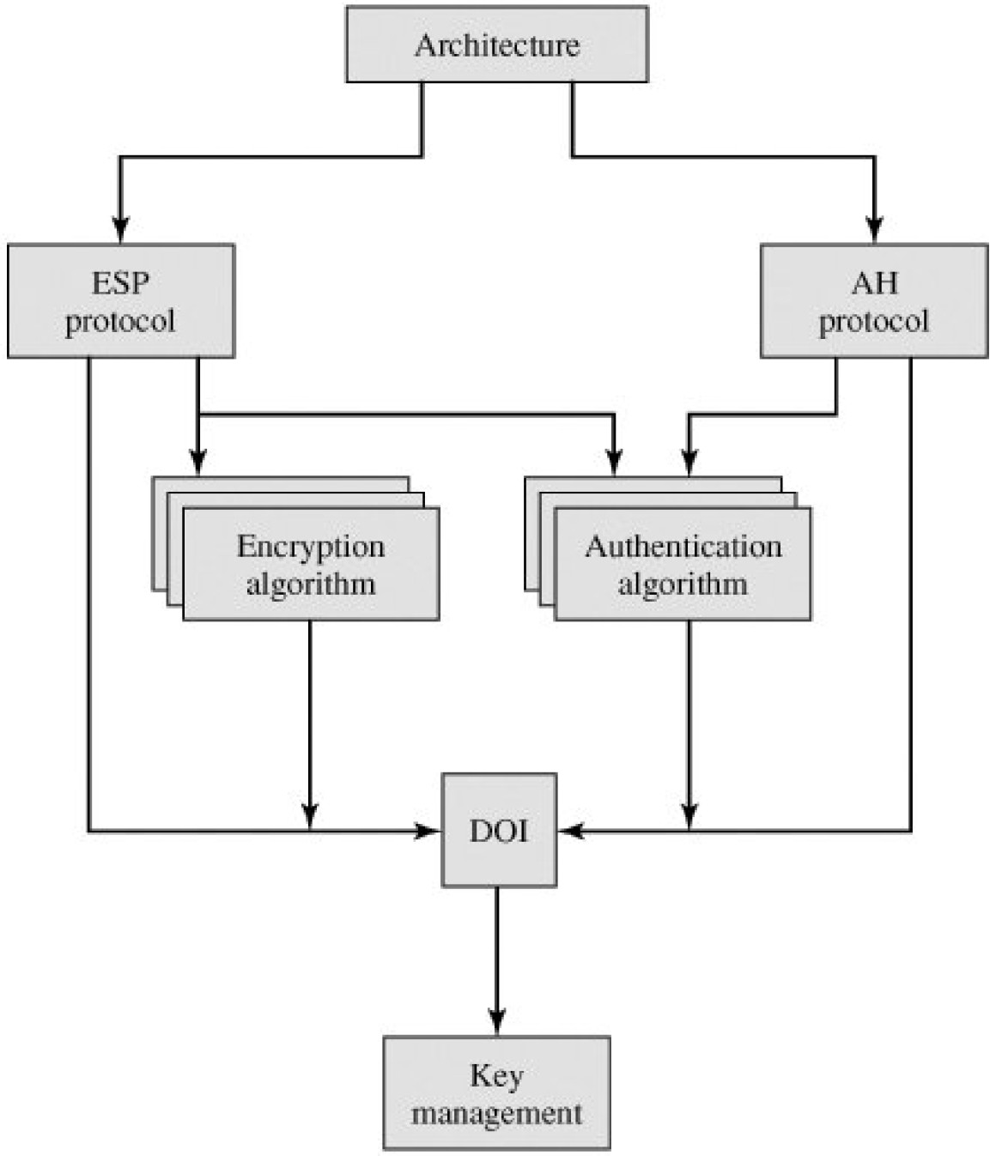

Slide 11

SEVEN GROUPS
 Architecture
 Encapsulating Security Payload (ESP)
 Authentication Header (AH)
 Encryption algorithms
 Authentication algorithms
 Key management
 Domain of Interpretation (DOI)

Slide 12
~ From RFC 2406
ESP is used to provide confidentiality, data origin authentication, connectionless integrity, an anti-replay service (a form of partial sequence integrity), and limited traffic flow confidentiality. The set of services provided depends on options selected at the time of Security Association establishment and on the placement of the implementation. Confidentiality may be selected independent of all other services.
However, use of confidentiality without integrity/authentication (either in ESP or separately in AH) may subject traffic to certain forms of active attacks that could undermine the confidentiality service. Data origin authentication and connectionless integrity are joint services (hereafter referred to jointly as "authentication) and are offered as an option in conjunction with (optional) confidentiality. The anti- replay service may be selected only if data origin authentication is selected, and its election is solely at the discretion of the receiver. (Although the default calls for the sender to increment the Sequence Number used for anti-replay, the service is effective only if the receiver checks the Sequence Number.) Traffic flow confidentiality requires selection of tunnel mode, and is most effective if implemented at a security gateway, where traffic aggregation may be able to mask true source-destination patterns. Note that although both confidentiality and authentication are optional, at least one of them MUST be selected.

Slide 13

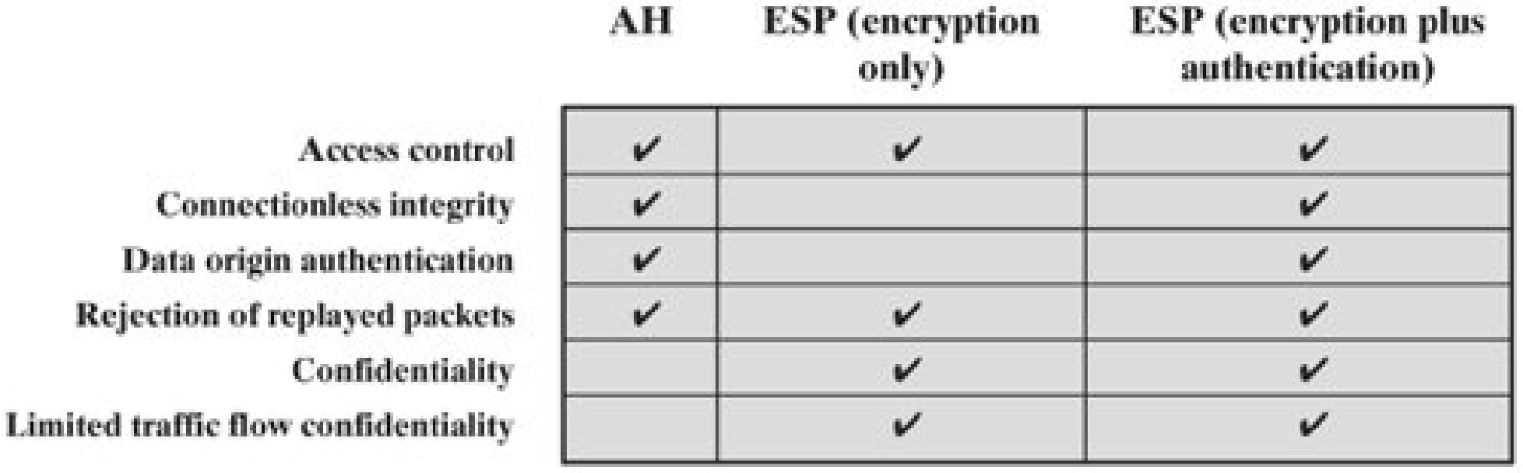
IPSec Services

Slide 14
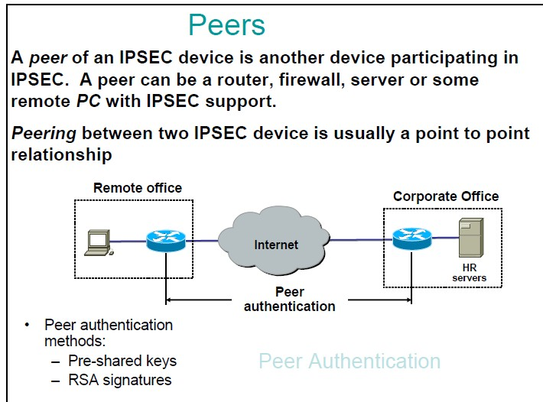

Slide 15
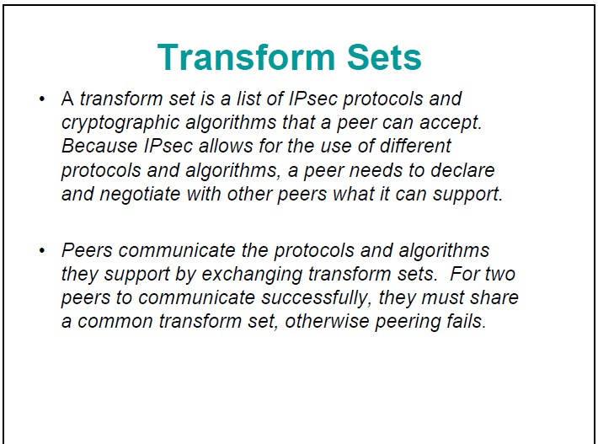

Slide 16
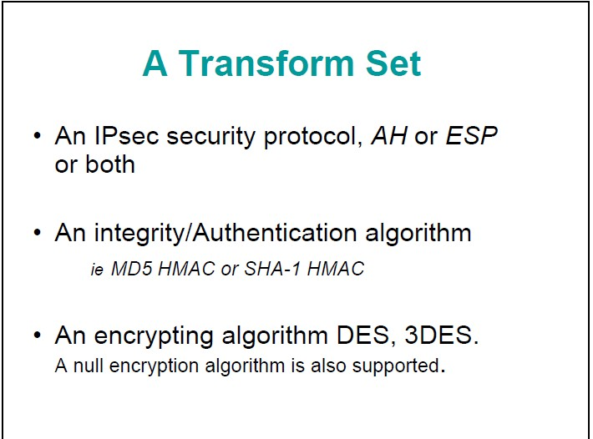

Slide 17
SECURITY ASSOCIATIONS
 A one-way relationship between sender & receiver that affords security for traffic flow
 Defined by 3 parameters:
 Security Parameters Index (SPI): The SPI is carried in AH and ESP headers to enable the receiving system to select the SA under which a received packet will be processed.
 IP Destination Address: the address of the destination endpoint of the SA
 Security Protocol Identifier: indicates whether the association is an AH or ESP security association

Slide 18
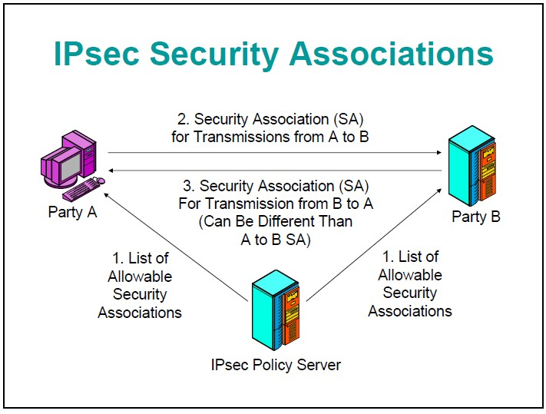

Slide 19
SECURITY ASSOCIATIONS
 A number of other parameters in SA
Sequence Number (SN) Counter: 32-bit for SN
SN Overflow: a flag indicating overflow of SN
Anti-Replay Window: an AH or ESP packet is a replay?
AH Information: related parameters used with AH
ESP Information: related parameters used with ESP
Lifetime of the SA
IPSec Protocol Mode: tunnel, transport
Path MTU: observed path maximum transmission unit
 Authentication and privacy is independent of any specific key management mechanism

Slide 20
 Security Policy Database (SPD)
 Entry defined by set of IP and upper layer protocol field values called selectors.
 Selectors can be dest ip, src ip, user id, data sensitivity,transport layer protocol,src port and dest port .
 Store policies
r When sending IPsec datagram, sender accesses SAD (Security Association Database)to determine how to process datagram.
r When IPsec datagram arrives to receiver ,examines SPI in IPsec datagram, indexes SAD with SPI, and processes datagram accordingly.
 Policy: For a given datagram, sending entity needs to know if it should use IPsec.
 Needs also to know which SA to use
 May use: source and destination IP address; protocol number.
 Info in SPD indicates “what” to do with arriving datagram;
 Info in the SAD indicates “how” to do it.

Slide 21
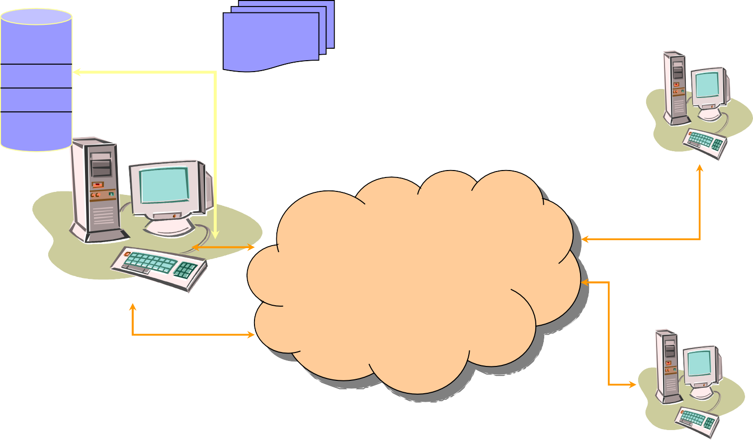
HOW THEY FIT TOGETHER
SPD
SA-1 SA-2
SADB
SPI
SPI
‹#›

Slide 22
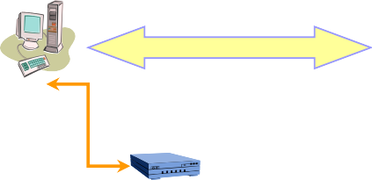
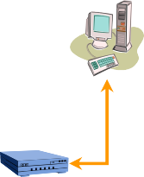


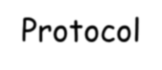








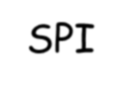


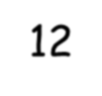



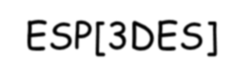





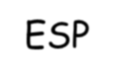
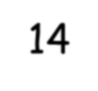
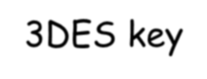
SPD AND SADB EXAMPLE
Transport Mode
A’s SPD
From | To | Protocol | Port | Policy
A | B | Any | Any | AH[HMAC-MD5]
From | To | Protocol | SPI | SA Record
A | B | AH | 12 | HMAC-MD5 key
A
B
C
D
Tunnel Mode
A’s SADB
From | To | Protocol |  | Port |  | Policy |  | Tunnel Dest
^{A}sub | ^{B}sub | Any |  | Any |  | ESP[3DES] |  | D
From | To |  | Protocol |  | SPI |  | SA Record
^{A}sub | ^{B}sub |  | ESP |  | 14 |  | 3DES key
C’s SPD
C’s SADB
‹#›

Slide 23
AUTHENTICATION HEADER (AH)
 Provides support for data integrity & authentication of IP packets
 end system/router can authenticate user/app
 prevents address spoofing attacks by tracking sequence numbers
 HMAC-MD5-96 or HMAC-SHA-1-96
- parties must share a secret key

Slide 24
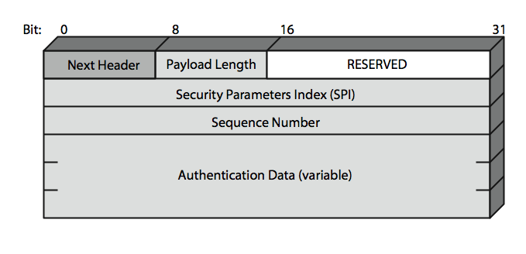
AUTHENTICATION HEADER

Slide 25
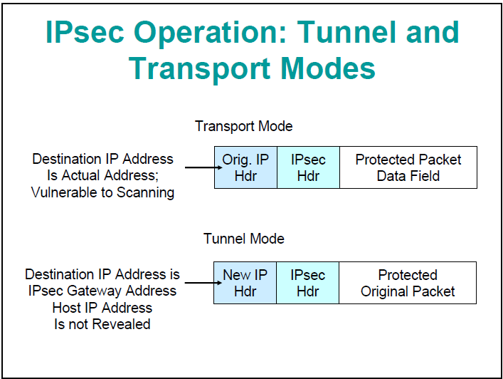

Slide 26
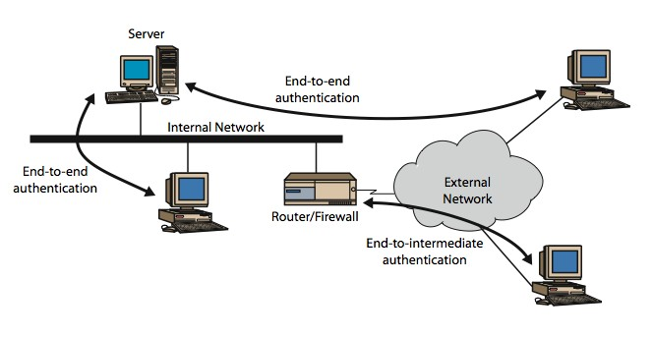
TRANSPORT & TUNNEL MODES
Transport mode
Tunnel mode

Slide 27
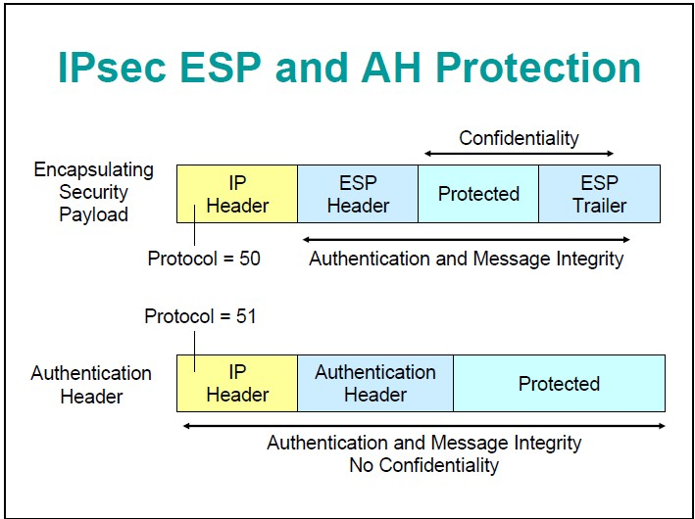

Slide 28
ENCAPSULATING SECURITY PAYLOAD (ESP)
 Provides message content confidentiality & limited traffic flow confidentiality
 ESP can optionally provide the same authentication services as AH
 ESP supports a range of ciphers, modes, padding
 incl. DES, Triple-DES, RC5, IDEA, CAST etc
 CBC & other modes
 padding needed to fill block size, fields, for traffic flow

Slide 29
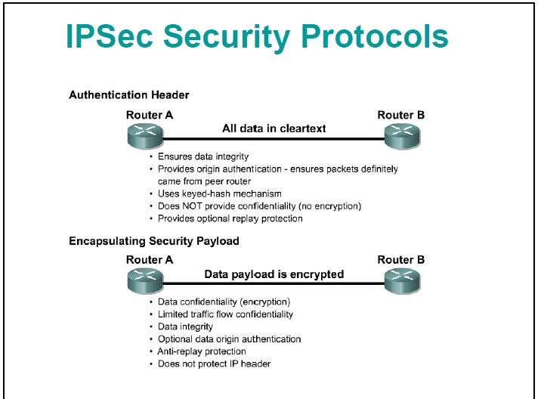

Slide 30
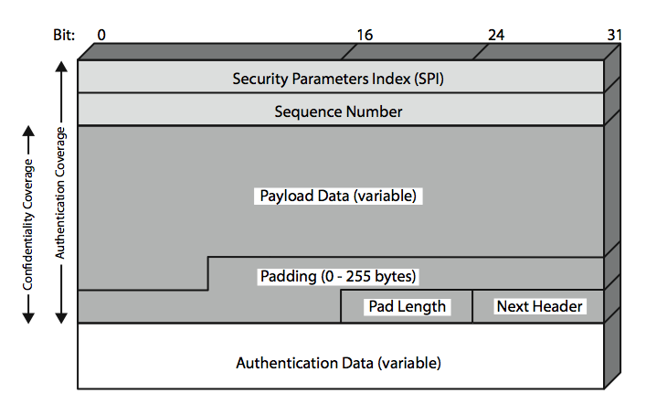
ENCAPSULATING SECURITY PAYLOAD

Slide 31
“enchilada” authenticated
encrypted
new IP
header
ESP original
hdr IP hdr
Original IP datagram payload
ESP ESP
trl auth
SPI
Seq
#
padding
pad length
next header
Appends to back of original datagram (which includes original header fields!) an “ESP trailer” field.
Encrypts result using algorithm & key specified by SA.
Appends to front of this encrypted quantity the “ESP header, creating
“enchilada”.
Creates authentication MAC over the whole enchilada, using algorithm and key specified in SA;
Appends MAC to back of enchilada, forming payload;
Creates brand new IP header, with all the classic IPv4 header fields, which it appends before payload.

Slide 32
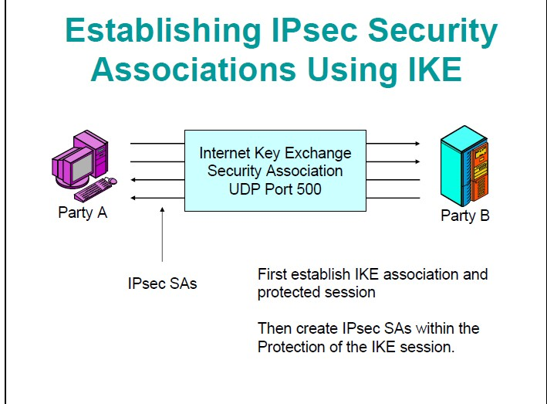

Slide 33
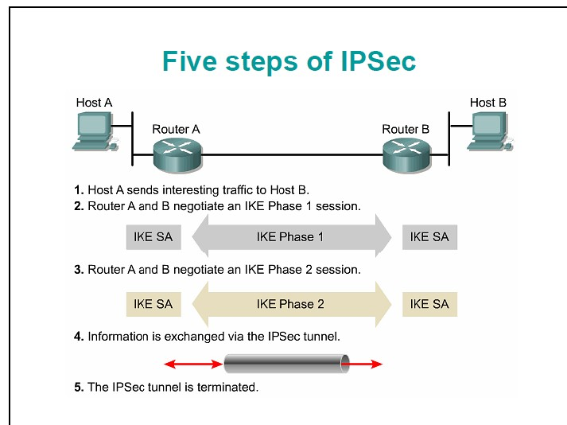

Slide 34
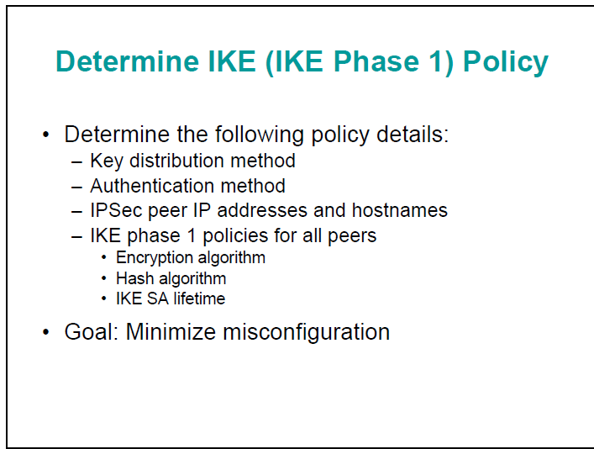

Slide 35
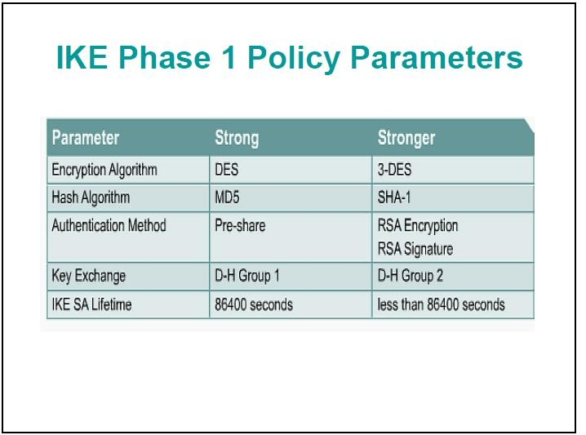

Slide 36

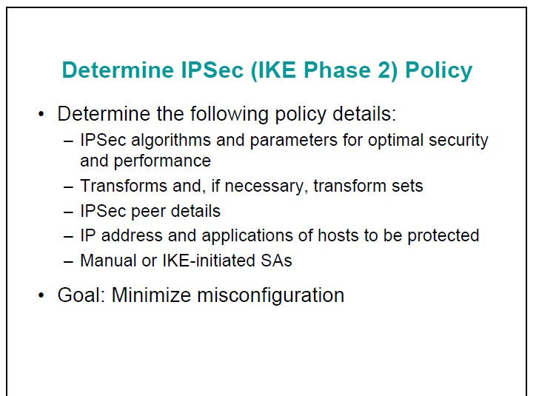

Slide 37

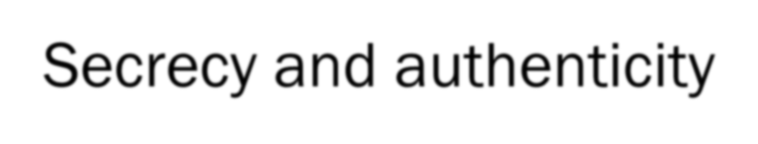

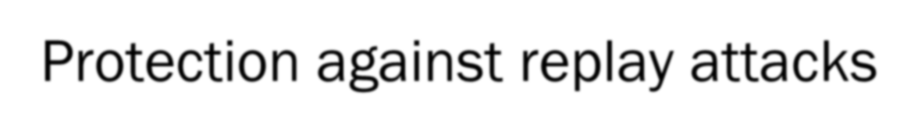
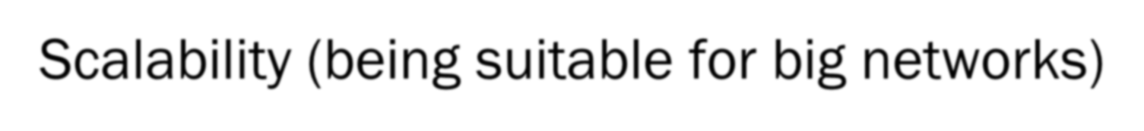
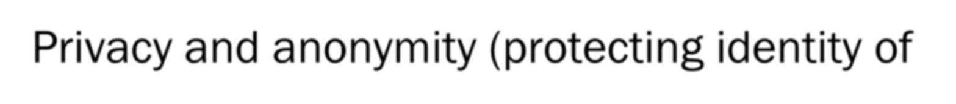
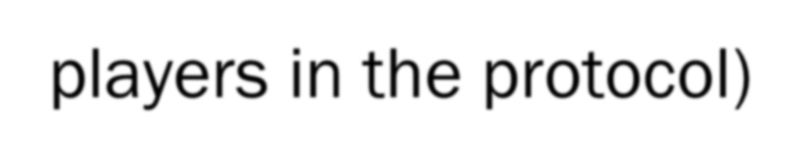
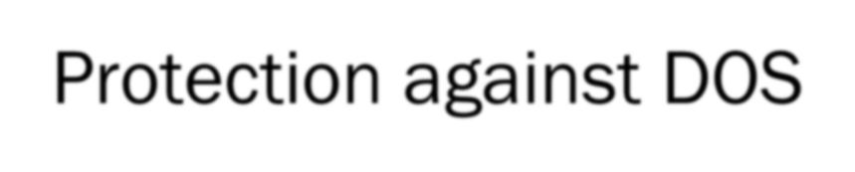
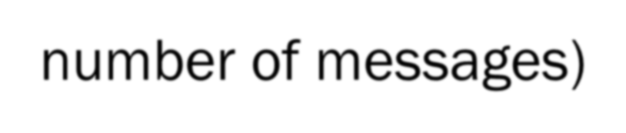
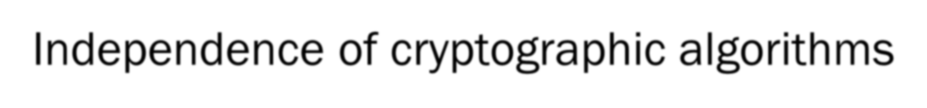


Expectations from IKE
Secrecy and authenticity
Protection against replay attacks
Scalability (being suitable for big networks)
Privacy and anonymity (protecting identity of players in the protocol)
Protection against DOS
Efficiency (both computational and minimal in the number of messages)
Independence of cryptographic algorithms
Minimize protocol complexity
Reliability

Slide 38

HOW IT WORKS
 IKE has two phases
 Phase 1: Establish bi-directional IKE SA
 Note: IKE SA different from IPsec SA
 Also called ISAKMP security association
 Phase 2: ISAKMP is used to securely negotiate the IPsec pair of SAs
 Phase 1 has two modes: aggressive mode and main mode
 Aggressive mode uses fewer messages
 Main mode provides identity protection and is more flexible
 Both phases use Diffie-Hellman key exchange to establish a shared key

Slide 39

IKE PHASE 1
 Goal: to establish a secure channel between two end points
 This channel provides basic security features:
 Source authentication
 Data integrity and data confidentiality
 Protection against replay attacks

Slide 40
IKE PHASE 1
 Rationale: each application has different security requirements
 But they all need to negotiate policies and exchange keys!
 So, provide the basic security features and allow application to establish custom sessions

Slide 41

PHASE 1 EXCHANGE
 Can operate in two modes:
 Main mode
 Six messages in three round trips
 More options
 Quick mode
 Four messages in two round trips
 Less options

Slide 42

PHASE 1 (MAIN MODE)
Initiator
[Header, SA₁]
Responder

Slide 43
PHASE 1 (MAIN MODE)
Initiator
[Header, SA₁]
Responder
[Header, SA₂]
Establish vocabulary for further communication

Slide 44
PHASE 1 (MAIN MODE)
Initiator
[Header, SA₁]
Responder
[Header, SA₂]
[Header, KE, Ni, {Cert_Reg} ]

Slide 45
PHASE 1 (MAIN MODE)
Initiator
Header, SA₁
Responder
[Header, SA₁]
[Header, KE, Ni { , Cert_Req} ]
[Header, KE, Nr {, Cert_Req}]
Establish secret key using Diffie-Hellman key exchange
Use nonces to prevent replay attacks

Slide 46
PHASE 1 (MAIN MODE)
Initiator
[Header, SA₁]
Responder
[Header, SA₁]
[Header, KE, Ni {,Cert_Req} ]
[Header, KE, Nr {,Cert_Req}]
[Header, IDi, {CERT} sig]

Slide 47
PHASE 1 (MAIN MODE)
Initiator
[Header, SA₁]
Responder
[Header, SA₁]
[Header, KE, Ni {, Cert_req}]
[Header, KE, Nr {, Cert_req}]
[Header, IDi, {CERT} sig]
[Header, IDr, {CERT} sig]
Signed hash of IDi (without Cert_req , just send the hash)

Slide 48
PHASE 1 (AGGRESSIVE MODE)
Initiator
[Header, SA₁, KE, Ni, IDi]
Responder

Slide 49
PHASE 1 (AGGRESSIVE MODE)
Initiator
[Header, SA₁, KE, Ni, IDi]
Responder
[Header, SA₂, KE, Nr, IDr, [Cert]sig]
[Header, [Cert]sig]
First two messages combined into one (combine Hello and DH key exchange)

Slide 50

IPSEC (PHASE 1)
 Four different way to authenticate (either mode)
 Digital signature
 Two forms of authentication with public key encryption
 Pre-shared key
 NOTE: IKE does use public-key based cryptography for encryption

Slide 51

IPSEC (PHASE 2)
 Goal: to establish custom secure channels between two end points
 End points are identified by <IP, port>:
 e.g. <www.mybank.com, 8000>
 Or by packet:
 e.g. All packets going to 128.124.100.0/24
 Use the secure channel established in Phase 1 for communication

Slide 52
TRANSPORT VS TUNNEL MODE ESP
 Transport mode is used to encrypt and optionally authenticate IP data
 data protected but header left in clear
 good for ESP host to host traffic
 Tunnel mode encrypts the entire IP packet
 add new header for next hop
 good for VPNs, gateway to gateway security

Slide 53
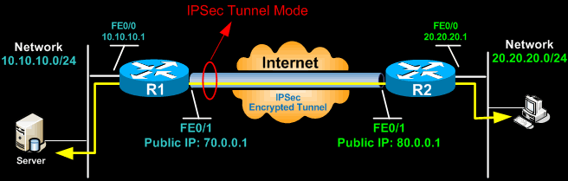
IPSec tunnel mode is the default mode.
Tunnel mode is used to encrypt traffic between secure IPSec Gateways( for example two Cisco routers connected over the Internet via IPSec VPN.)
Traffic from the client is encrypted, encapsulated inside a new IP packet and
sent to the other end.
In tunnel mode, an IPSec header (AH or ESP header) is inserted between the IP header and the upper layer protocol

Slide 54



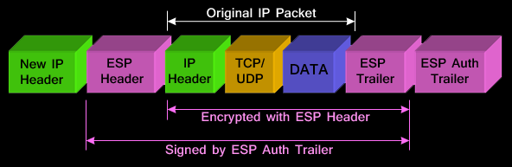
IPSEC TUNNEL MODE WITH ESP HEADER:
ESP is identified in the New IP header with an IP protocol ID of 50.

Slide 55



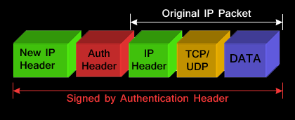
IPSEC TUNNEL MODE WITH AH HEADER:
The AH can be applied alone or together with the ESP, when IPSec is in tunnel mode.
AH’s job is to protect the entire packet.
The AH does not protect all of the fields in the New IP Header because some change in transit, and the sender cannot predict how they might change.
The AH protects everything that does not change in transit.
AH is identified in the New IP header with an IP protocol ID of 51.

Slide 56
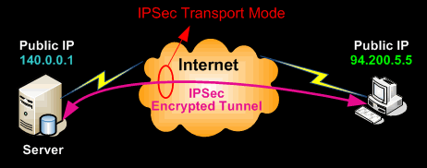
Transport mode provides the protection of our data, also known as IP Payload, and consists of TCP/UDP header + Data, through an AH or ESP header.
The payload is encapsulated by the IPSec headers and trailers.
The original IP headers remain intact, except that the IP protocol field is changed to ESP (50) or AH (51), and the original protocol value is saved in the IPsec trailer to be restored when the packet is decrypted.
IPSec transport mode is usually used when another tunneling protocol (like GRE) is used to first encapsulate the IP data packet, then IPSec is used to protect the GRE tunnel packets. IPSec protects the GRE tunnel traffic in transport mode.

Slide 57


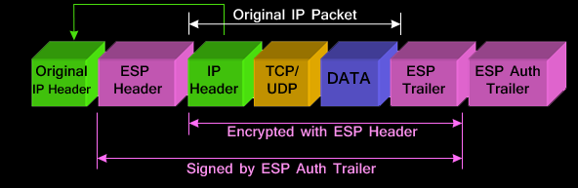
IPSEC TRANSPORT MODE WITH ESP HEADER:
the original IP Header is moved to the front.
Placing the sender’s IP header at the front (with minor changes to the protocol ID), proves that transport mode does not provide protection or encryption to the original IP header .
ESP is identified in the New IP header with an IP protocol ID of 50.

Slide 58

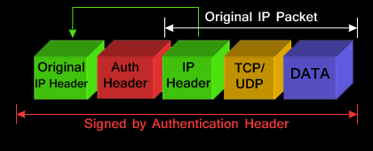
IPSEC TRANSPORT MODE WITH AH HEADER:
The AH can be applied alone or together with the ESP when IPSec is in
transport mode.
AH’s job is to protect the entire packet, however, IPSec in transport mode does not create a new IP header in front of the packet but places a copy of the original with some minor changes to the protocol ID therefore not providing essential protection to the details contained in the IP header (Source IP, destination IP etc).
AH is identified in the New IP header with an IP protocol ID of 51.

Slide 59
COMBINING SECURITY ASSOCIATIONS
 SA’s can implement either AH or ESP (but not
both)
 To implement both need to combine SA’s
 form a SA bundle
 may terminate at different or same endpoints
 combined by
 transport adjacency
 iterated tunneling
 issue of authentication & encryption order

Slide 60
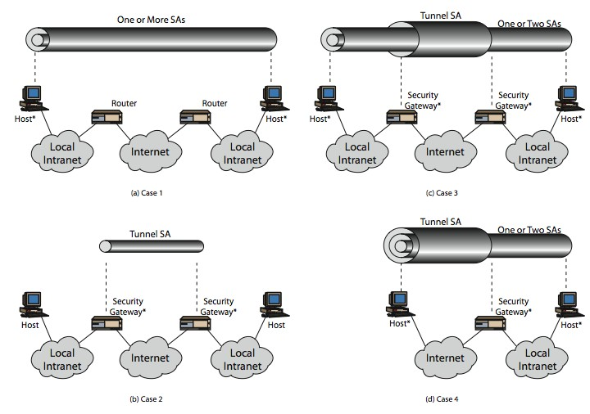
Transport mode
Tunnel mode

